Slide 1
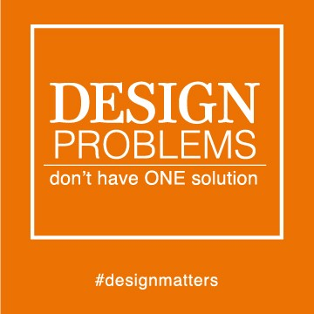
Lesson Tool 3: Design problems and solution
After studying this lesson tool, you should:
Understand the problems of designing an interactive system and specifically:
  How the natural evolution of design is obstructed
  Common mistakes designers make
Understand and be able to apply the design practices and tools to avoid the problems with the design of interactive systems, namely:
  Mechanisms such as affordance, constraints, mapping, visibility and feedback
  Design guidelines, principles and standards
A substantial part of this lesson tool is based on the work of Don Norman presented in his most important book “The Design of Everyday” Things.

Slide 2
  Design Problems
There are, potentially, many mistakes that designers can make.
Norman (1999) points out the following as being the most problematic:
  The forces that work against evolutionary design,
  Putting aesthetics first (form over function) and
  Designers regarding themselves as typical users.
HAMPERING THE NATURAL EVOLUTION OF DESIGN
Norman (1999) coined term “evolutionary design”.
  Refers to the process whereby a product is gradually improved over time
  Occurs when a design evolves through a cycle of testing, identifying problems, modification, redesign, retesting and remodification until a functional, aesthetically pleasing object is achieved.
    ▪ Good features kept, bad features replaced with improved ones.
Three forces work against evolutionary design:
The demands of time
  New version of object often released before old one has been updated.
  The release of a newer version with bugs - releasing on promised date is more important than providing a bug-free application - need for “service packs” and “hot fixes”.
Pressure to be distinctive
  Each design must have features to distinguish it from previous versions to lure consumers
  New model often doesn’t include the good qualities of its former version.
The curse of individuality and market differentiation
  Companies that manufacture the same type of product have to come up with a unique design which carries their signature.
  If a company perfects a product, other companies manufacturing same product often make an inferior product in the name of individuality.
  Quest for individuality can lead to innovative solutions to real problems
    Main goal should be to improve product or solve the problem, not just stand out

Slide 3
COMMON DESIGN MISTAKES
Lesson tool 2 addressed general mistake of designing for the typical user. Further issues: Overestimating importance of aesthetic (artistic) ,designers being considered typical users and problem with cluttered interfaces.
Putting Aesthetics above Usability
Apple paid special attention to the aesthetics of their products.
Aesthetics should not take precedence over usability
An interface need not be an artwork to be aesthetically pleasing.
  • One that is free of clutter, interface elements organised in logical and balanced way, and uses colour tastefully can provide visual pleasure to users
  • The target user group should be considered – adults vs young children
  • Culture may also determine what the user finds aesthetically pleasing.
Google.com: Proof that a beautiful interface is not a prerequisite for a successful system.
Thinking for the User
Common Errors:
  Designers subconsciously build interfaces according to their own preferences & knowledge. They believe they know what users want
By time a system is complete, designers know it so well that they can’t view it from perspective of someone who encounters it for the first time.
Happens if designers do not involve real users in the design process
  To mistake the client for the end user and base the designs on the requirements specified by the client.
Cluttering the Interface
Interfaces should provide users with enough information to allow them to perform their required task successfully.
They should, however, avoid screen clutter:
  Affects aesthetics of the design
  Difficult for users to take in and understand the profusion(flooding) of objects on the screen
  The more objects on the screen:
    ▪ More meanings users will have to unravel (understand)
    ▪ Harder for users to find the ones that they really need.
    ▪ The smaller the average size of each object
Design Solutions
Most basic principles for good interface design can be derived from Norman’s (1999) good principles for the design of everyday things.

Slide 4
Below describes his well-known and widely accepted design concepts:
Affordance
The affordance of an object or interface refers to the perceived and actual properties that tell an observer or user how the object or interface can be used. E.g. Scissors
The stronger the clues provided by the affordances, the better user will know what to do.
Constraints - A constraint is a mechanism that restricts the allowed behaviour of a user when interacting with a computer system.
Physical – relies on properties of the physical world for its use, e.g. ATM – card slot
  ▪ Forcing function - type of physical constraint
      • Requires one action before a next can take place
Sematic - rely on the meaning of the situation, e.g. Red robot
Cultural – rely on accepted cultural conventions, e.g. green button (OK | Go)
Logical - rely on logical relationships between functional and spatial aspects of a situation, e.g. natural mappings
Mapping
Mapping refers to the relationship between two things o E.g. relationship between a device’s controls and their movements, and the results of the actual use of these controls.
A good mapping enables users to determine the relationships between possible actions and their respective results.
Natural mappings use physical analogy and cultural standards to support interpretation.
Visibility
The parts of a system that are essential for its use must be visible.
Visible structure of well-designed objects gives user clues about how to operate them.
  Clues take the form of affordances, constraints and mappings.
  Visible signs (like letters or the colour)
Absence of text labels to icons makes it difficult for users to interpret them.
Sound can also be used to make interface elements more visible – beep on error messages

Slide 5
Feedback
Feedback is information that is sent back to the user about what action has actually been performed, and what the result of that action is.
Operations that take time are often indicated by a progress bar or a message.
Without constant feedback, the interaction process will be very unsatisfactory.
Novices want informative feedback. Frequent users want less distracting feedback.
Important Feedback Mechanisms:
  Sound – E.g. cars – beeping (fasten belt or petrol empty)
  Absence of sound – e.g. kettle, no sound means it’s not working
GUIDELINES, PRINCIPLES AND STANDARDS
The aim with design guidelines, standards and design principles
  To help designers to improve the usability of their products by giving them rules according to which they can make design decisions
    ▪ Such rules restrict range of design options and prevent designer from making choices likely to harm usability of the product
Design rules are classified as standards or guidelines.
Standards - usually set by national or international bodies and are authoritative and limited in application.
Guidelines - more general in application.
There are 2 types of design guidelines:
Low-level detailed rules
  Instructions that are application specific and do not need much interpretation.
High-level directing principles
  Relatively abstract and apply to different systems
The difference between design principles and usability principles:
Design principles usually inform the design of a system
Usability principles
  mostly used as basis for evaluating prototypes and complete systems
  can be more prescriptive than design principles
In practice, some design or usability principles are referred to as “heuristics”
Next are some of the most prominent sets of guidelines, namely those of Dix et al (2014), Preece et al (2007), Preece et al (2019) and Shneiderman (1998).

Slide 6
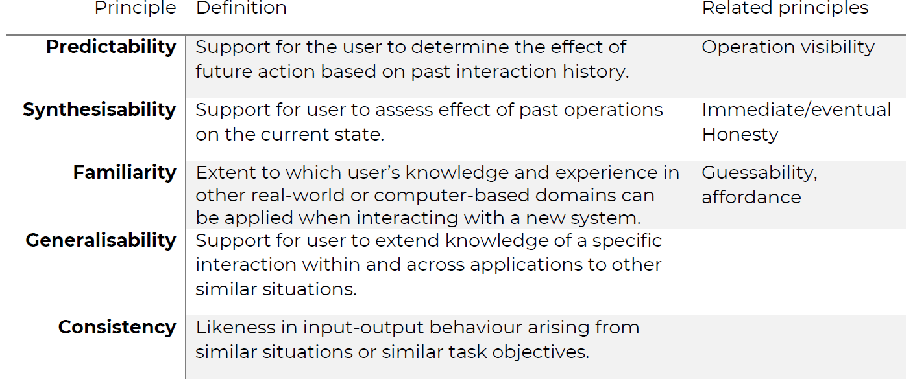
DIX, FINLAY, ABOWD AND BEALE
Dix et al (2014)
Provide interface designers with a comprehensive set of high-level directing principles with the aim of improving the usability of interactive systems.
Divide principles into three categories
  1. Learnability principles
  2. Flexibility principles
  3. Robustness principles
Learnability
Refers to the ease where users can enter a new system and reach a maximal level of performance.
Five principles affect the learnability of a computer-based system:

Slide 7
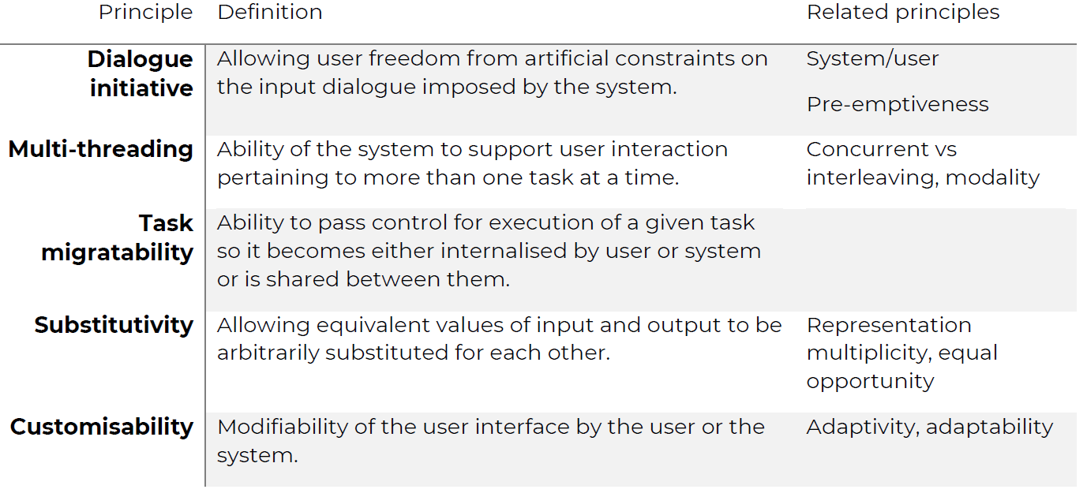
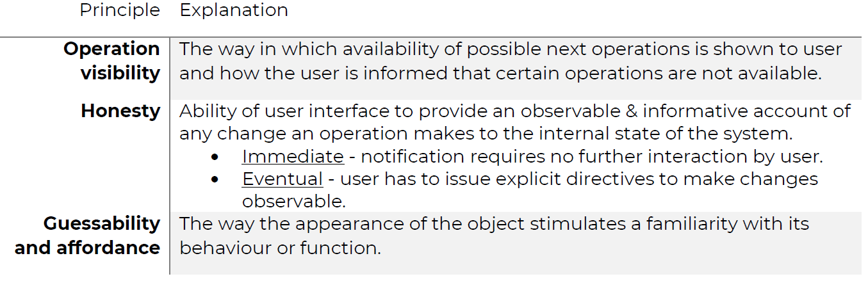
Principles that relate to Learnability principles
Flexibility
Refers to the many ways in which interaction between the user and the system can take place.
Principles that affect Flexibility

Slide 8
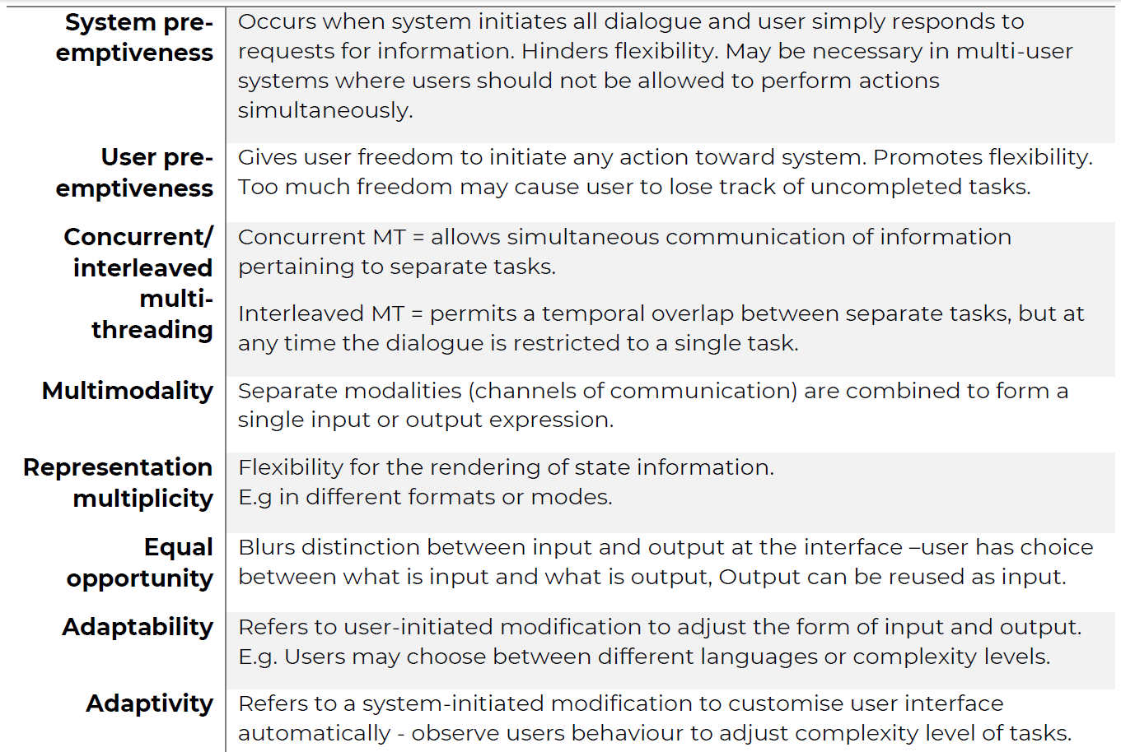
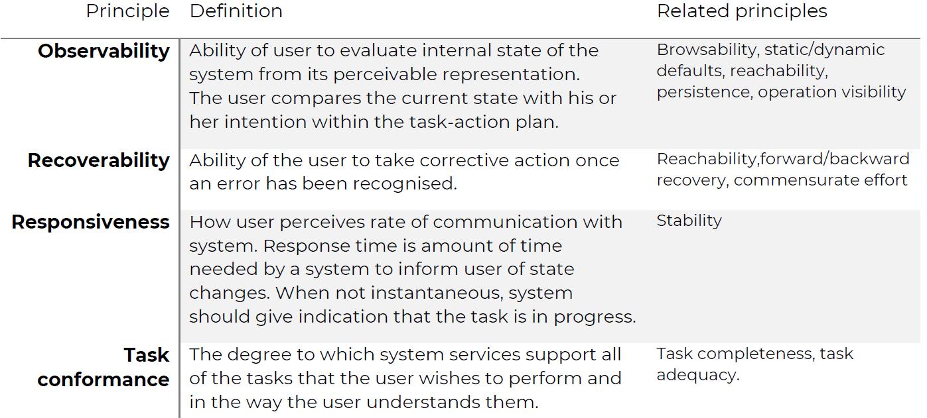
Principles that relate to Flexibility principles
Principle Explanation
Robustness: Refers to the level of support that users is given for the successful achievement and assessment of their goals.
Principles that affect Robustness

Slide 9
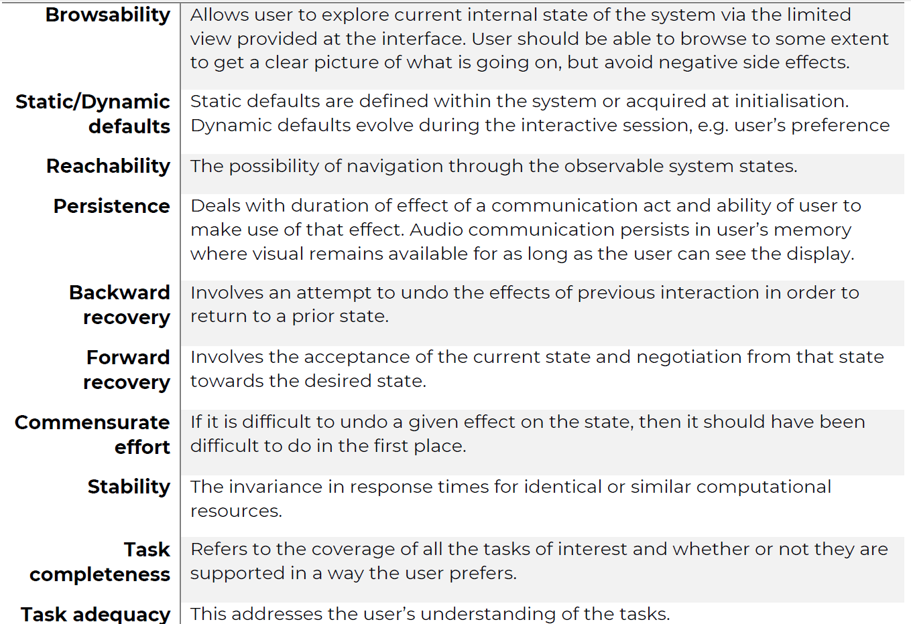
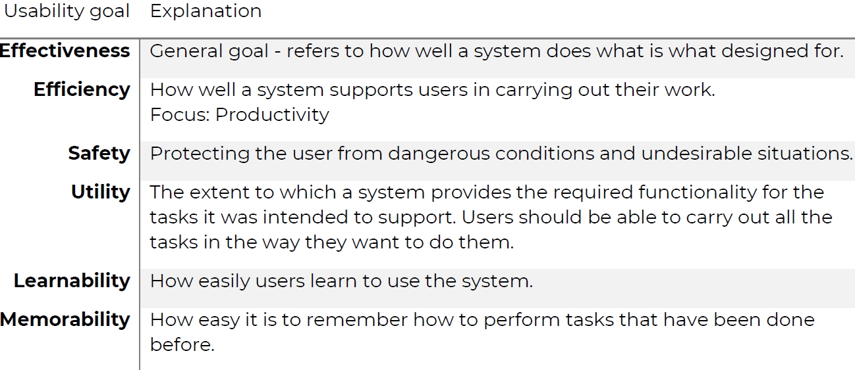
Principles that relate to Robustness principles
Principle Explanation
Preece, Rogers and Sharp
Preece et al (2019) - 2 types of design goals in interaction design:
Usability goals
  Focus on aspects such as effectiveness and learnability
User experience goals
  Concerned with quality of user’s experience with system
  Focus on aspects such as aesthetics and enjoyment
Usability Goals
Preece et al (2019) identified six usability goals that will ensure that users’ interaction with technology is effective and enjoyable.

Slide 10
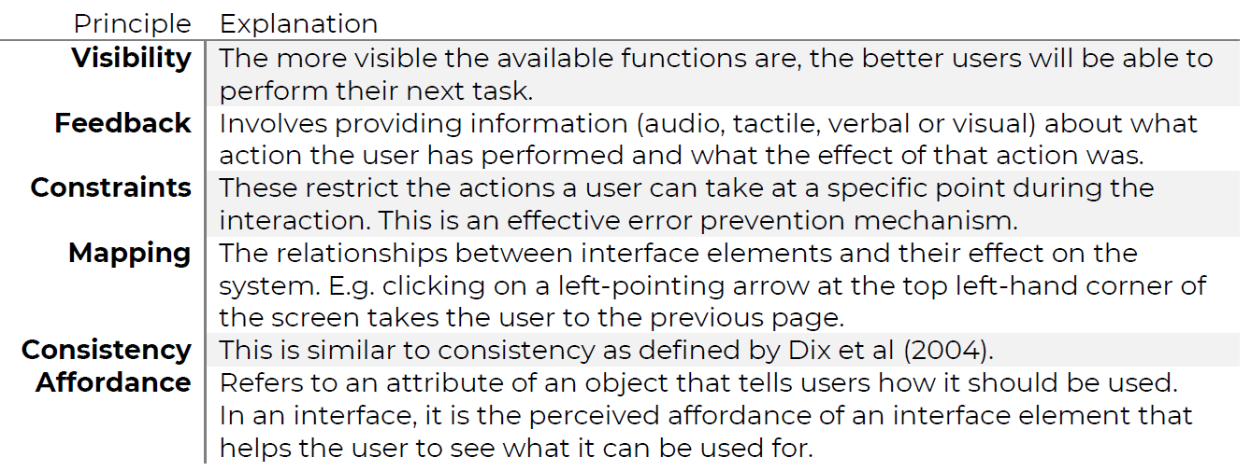
User Experience Goals
How user feels about a product, irrespective of efficiency, effectiveness, learnability and so on, plays an important role in it being well accepted or not.
To provide users with positive experiences of interaction, designers should attend to features that will make the product:
  satisfying, enjoyable, engaging, exciting, entertaining, helpful, motivating, aesthetically pleasing, supportive of creativity, cognitively stimulating, rewarding, provocative, surprising, emotionally fulfilling, challenging, sociability enhancing
Factors that may support the fulfilment of these user experience goals include
  Attention
  Pace
  Interactivity
  Engagement
  Style of narrative
Design Principles
According to Preece, design principles are prescriptive suggestions that help designers to explain or improve their designs.
Instead of telling designer exactly how to design an interface, they inspire careful design by telling the designer what will work and what not.
Summary of Preece et al’s (2019) discussion of design principles

Slide 11
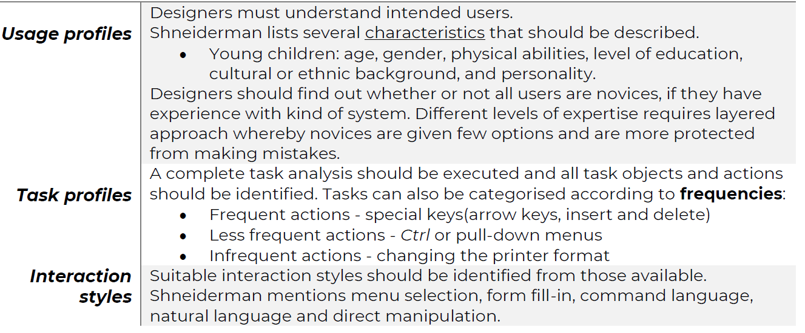
Shneiderman
Shneiderman’s principles for user-centred design (1998, 2014) are divided into 3 groups
  1. Recognition of diversity
  2. Golden rules
  3. Prevention of errors
Recognise Diversity
Before the task of designing a system can begin
  Information must be gathered about the intended users, their tasks, the environment of use and the frequency of use.
▪ Involves characterisation of 3 aspects relating to the intended system:

Slide 12
The Eight Golden Rules for Interface Design
Shneiderman et al (2014) suggested 8 principles of design applicable to most interactive systems.
They overlap to some extent with those of Dix et al (2004) and Preece et al (2019)
8 Principles
  1. Strive for consistency.
  2. Cater to universal usability, for example, enable frequent users to use shortcuts.
  3. Offer informative feedback.
  4. Design dialogues to yield closure (the completion of a group of actions).
  5. Offer error prevention and simple error handling.
  6. Permit easy reversal of actions.
  7. Support an internal locus of control (user should feel in control of system)
  8. Reduce short-term memory load.
Prevent Errors
Errors are made by even the most experienced users,e.g, users of cellphones, e-mail, spreadsheets, air-traffic control systems and other interactive systems
To reduce a loss in productivity due to errors
  Improve the error messages provided by the computer system.
  Effective approach is to prevent the errors from occurring.
    1. First step is to understand the nature of errors
    2. Next step is to organise screens and menus functionally by designing commands and menu choices that are distinctive and by making it difficult for users to perform irreversible actions.
3 techniques which can reduce errors by ensuring complete & correct actions (Shneiderman ):
Correct matching pairs • E.g. when user types a left parenthesis, system displays a message that right parenthesis is missing, and message disappears when user types it.
Complete sequences:
E.g. logging onto a network requires the user to perform a sequence of actions.
When the user does this for the first time, the system can store the information and henceforth allow the user to trigger the sequence with a single action.
The user is then not required to memorise the complete sequence.

Slide 13
3. Correct commands
To help users to type commands correctly, a system can employ command completion which will display complete alternatives as soon as the user has typed the first few letters of a command.
Design Standards
Standards concern prescribed ways of discussing, presenting or doing something.
The aim is to achieve consistency across products of the same type.
Standards for interactive system design are usually set by national or international bodies to ensure compliance with a set of design rules by a large community.
Standards can apply to either hardware or software used to build the interactive system.
Standardisation in interface design offers various benefits:
  Provides a common terminology so designers know they are discussing same concept
  Facilitates program maintenance and allows for additional facilities to be added
  Gives similar systems the same look and feel so that elements are easily recognisable
  Reduces training needs - knowledge can be transferred between standardised systems
  Promotes health and safety of users who will be less likely to experience stress or surprise due to unexpected system behaviour
A user interface design rule that is rigidly applied without taking the target user’s skills, psychological and physical characteristics or preferences into account, may reduce a product’s usability.
Standards must therefore always be used together with more general interface design principles.

Slide 14
Conclusion
Design guidelines do not provide recipes for designing successful systems. They only provide guidance and do not guarantee optimum usability. Even armed with very good guidelines, a designer should still make an effort to understand the technology and the tasks involved, the relevant psychological characteristics of the intended users, and what usability means in the context of the particular product.
Guidelines can help designers to identify good and bad options for an interface. They also restrict the range of techniques that can be used while still conforming to a particular style, but they can be very difficult to apply. In many ways they are only as good as the person who uses them. This is a critical point, because many companies view guidelines as a solution.
The way to improve an interface is not just to draft a set of rules about how many menu items to use or what colours make good backgrounds. We cannot emphasise enough that users’ tasks and basic psychological characteristics must be taken into account. Unless you understand these factors, guidelines will be applied incorrectly.
The End!!!!!!

